Slide 1

Social Media App (Chat Box)
Made by :-
Samarth Shrivastava(161B193)
Rishi Prajapati(161B177)
Garvit Singh Rajput(161B079)
Under the guidance of :-
Ms. Poonam Mandre

Slide 2
Contents

Slide 3
Introduction
Main aim of chat server application is to provide online chatting like chatting in facebook, chatting in google chat.
But this application doesn't have all the features that are present in facebook and google chat like video chat, adding symbols etc….
It is useful for students to discuss anything while in group or among themselves.
Messages are available only for a short period of time once the person reads it and then disappear hence the privacy is maintained and data leakage is less.

Slide 4
Technologies Used
BACKEND:-
Javascript
Node JS
J Query –
Socket .io
Express
FRONTEND:-
HTML

Slide 5


Slide 6
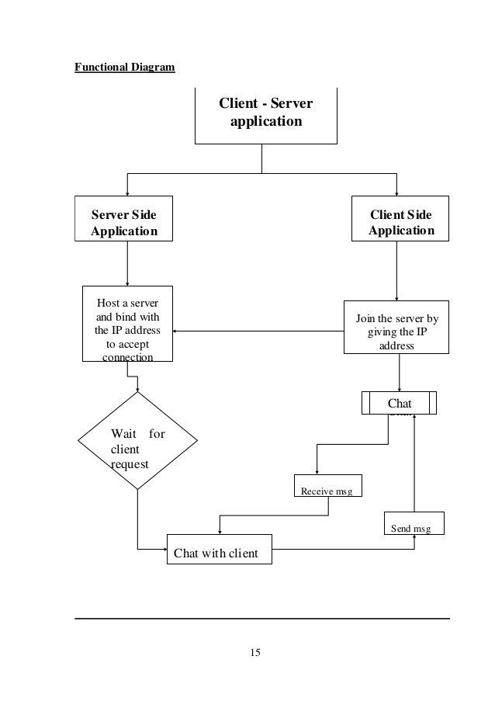

Slide 7
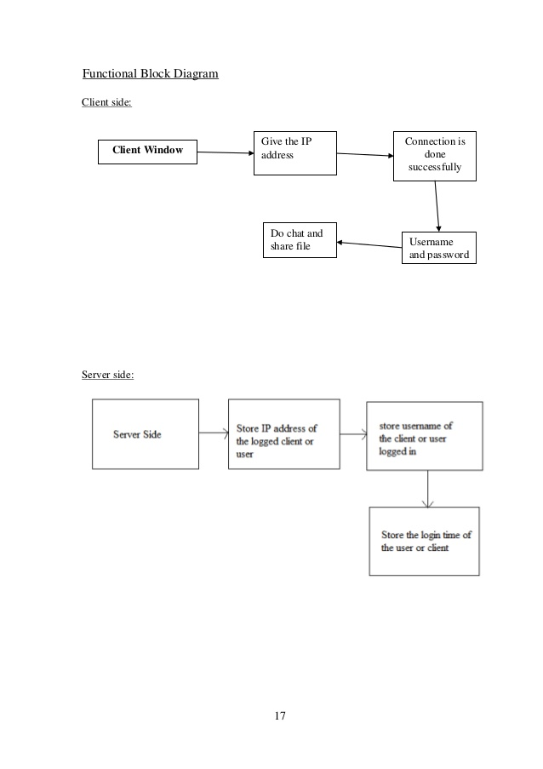

Slide 9
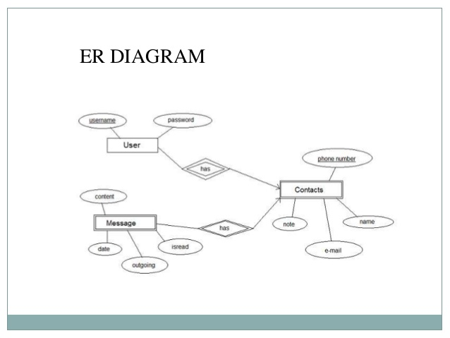

Slide 10
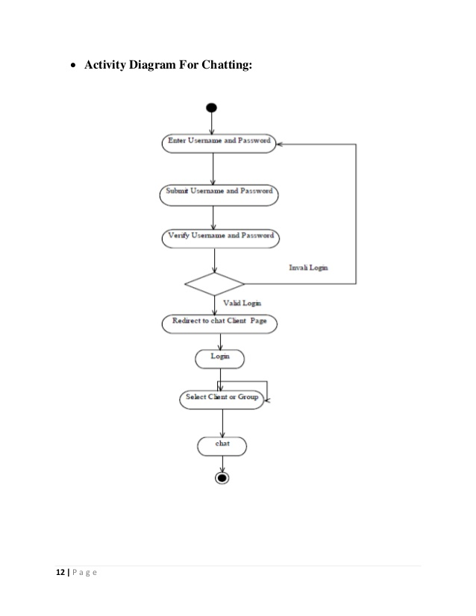

Slide 11
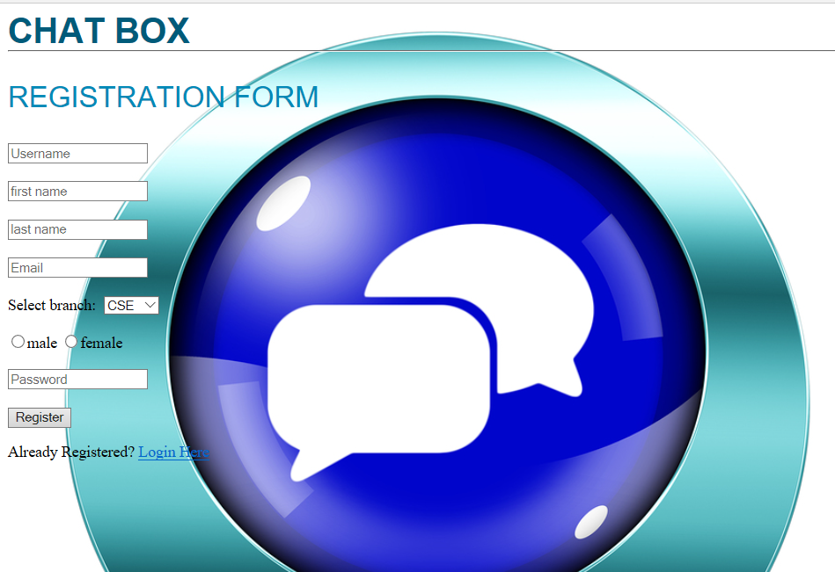

Slide 12
